Slide 1
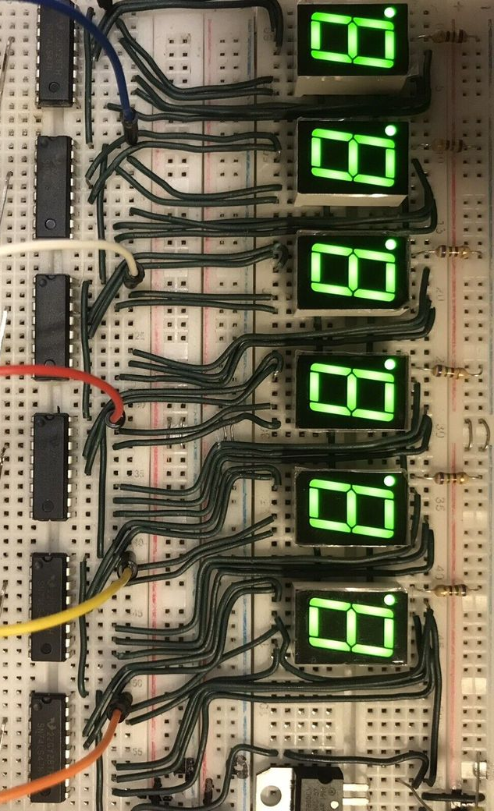

7 Segment LED Display
By
Moamen Ahmed Al-sayed
Code Baker

Slide 2


Slide 3
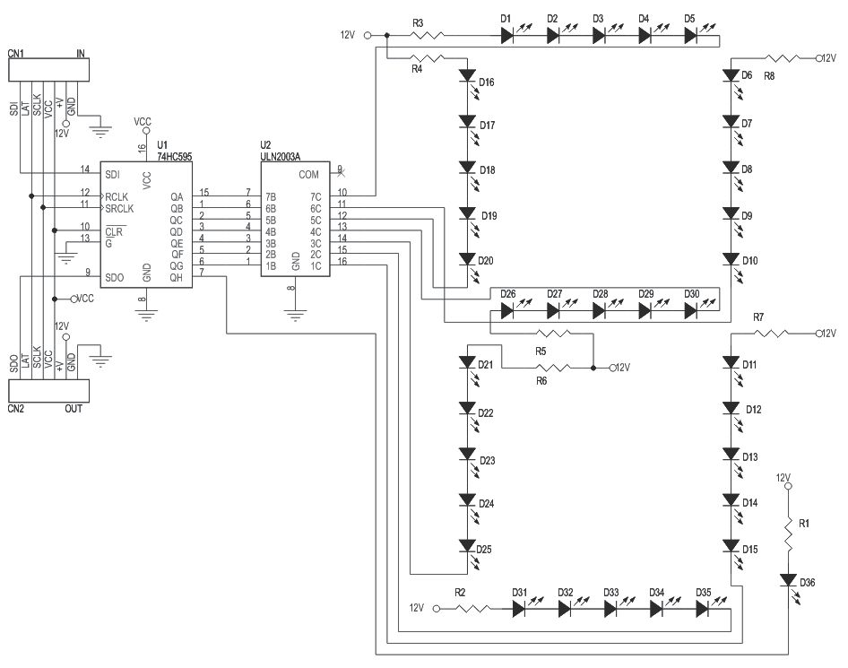
Outline
Understanding the 7-Segment Display
What is a 7-segment display?
How It Works & Testing
Types of 7-Segment Displays
Circuit Diagram and Connection
Using PIC 18F4620 MCU
Proteus 8 Professional Simulation
Binary Coded Decimal (BCD)
Basic definition and concept of BCD.
7448 & 7447 ICs
Multiplexer

Slide 4
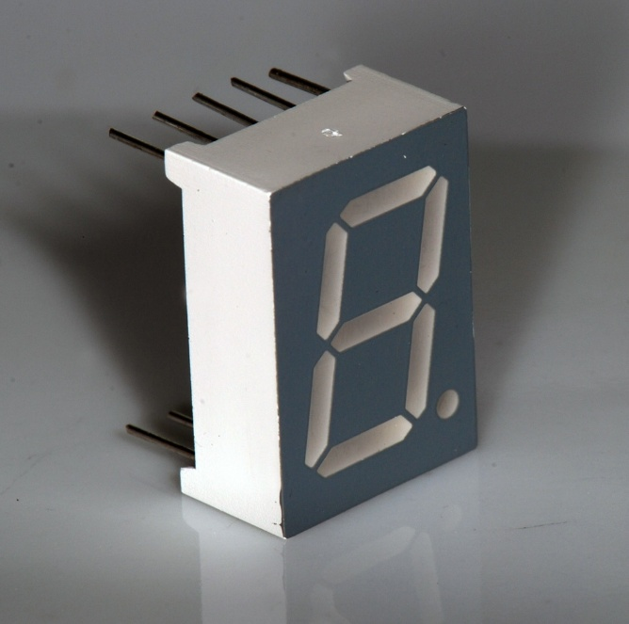
7-Segment display
An electronic display device used to represent decimal numbers (0–9)
Arranged in the shape of the number “8.”
By turning specific segments on or off, it can display each numeral clearly.
Pros
Simple and Easy to Use
Low Cost
Low Power Consumption

Slide 5
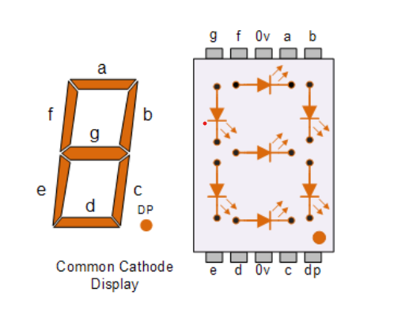
7-Segment Structure
These are individual LED , each segment can be turned on or off to form different digits.
Decimal Point (DP) (Optional)
Pins (Terminals)
7 for segments A–G
1 for DP
common pin.

Slide 6
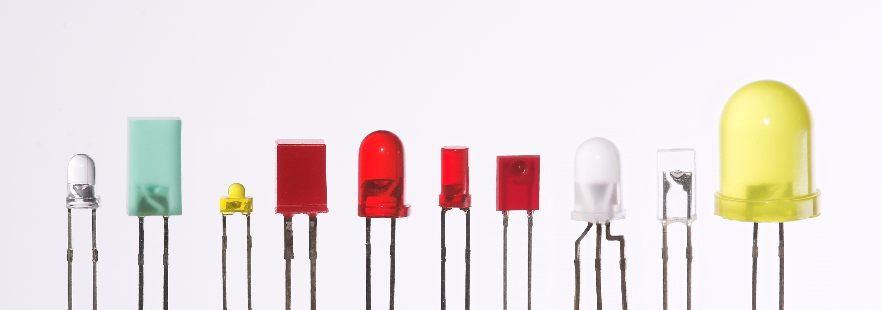
What is LED First ?
An LED circuit is an electrical circuit designed to power a light-emitting diode (LED).

Slide 7
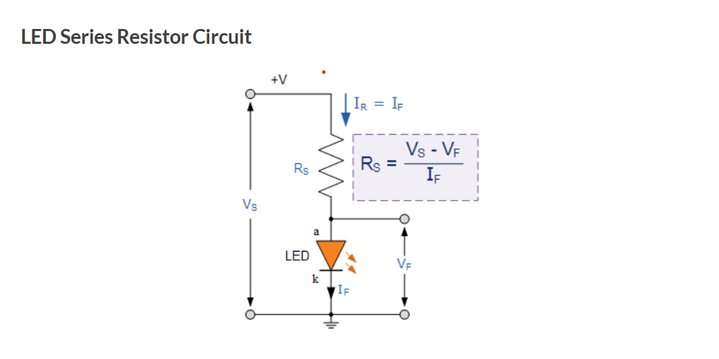
LED Circuit
Rs = 220-330 ohm
Ir = 15mA
Vf = 1.5 V

Slide 8
⚙️ How It Works
Each digit (0–9) is displayed by turning on a specific combination of segments.
🔹 Examples:
To display “1”, only segments B and C are turned on.
To display “8”, all seven segments A to G are turned on.
Signals (HIGH or LOW) are sent from a Microcontroller to control each segment.

Slide 9
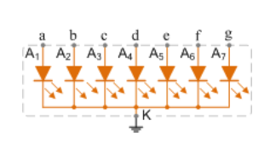
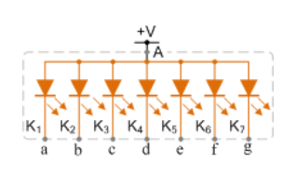
Types
Common Pin
Common Cathode: All negative terminals (cathodes) are connected together to GND.
Common Anode: All positive terminals (anodes) are connected together to VCC(+).

Slide 10
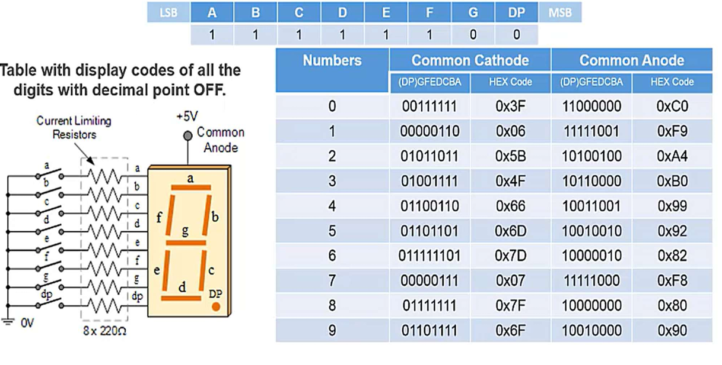

Slide 11
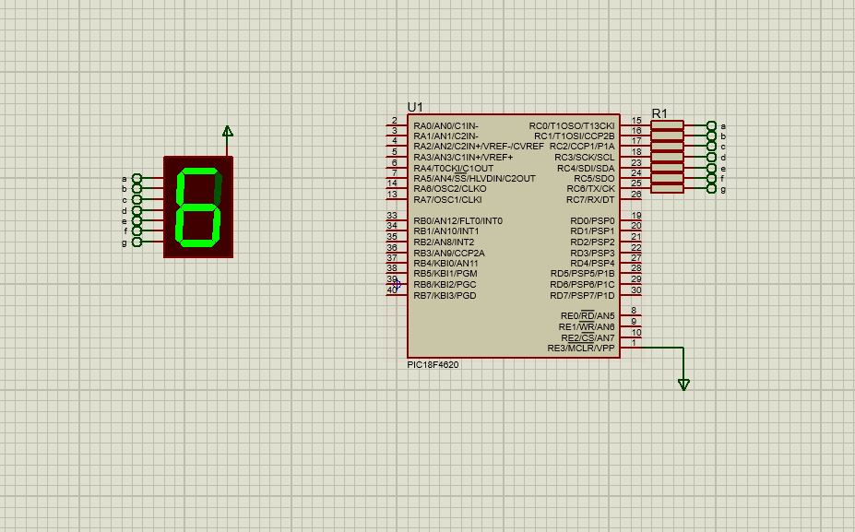

Slide 12
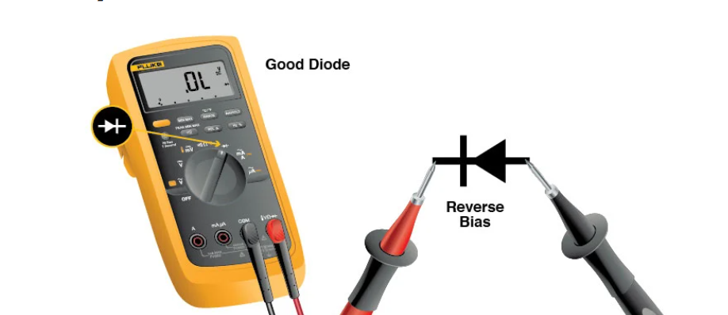
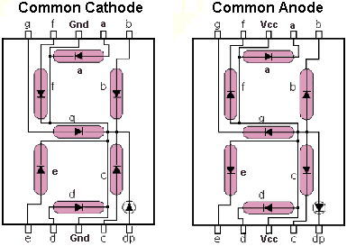
Testing
To Find the Common Cathode or Common Anode :-
Set the AVO meter to diode mode.
Place the black probe on one pin (assume it might be common).
Touch the red probe to the other pins, one by one:
If several segments light up dimly, that pin is common cathode (GND).
If you reverse the probes and they light up, it's common anode (VCC).

Slide 13
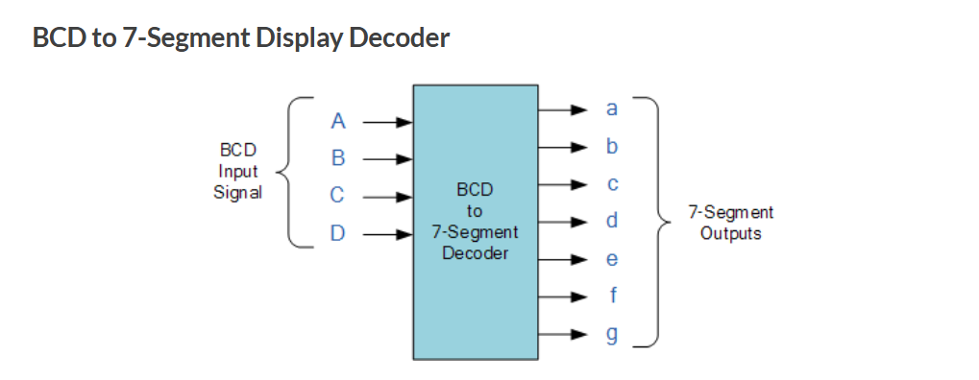
Binary Coded Decimal (BCD)
A Form Of Number Representation In Which Each Decimal Digit (0–9) Is Represented By Its 4-bit Binary.
Example:
Decimal 59 = 0101 1001 in BCD (5 = 0101, 9 = 1001)
Note : Only binary combinations from 0000 (0) to 1001 (9) are valid in BCD.

Slide 14
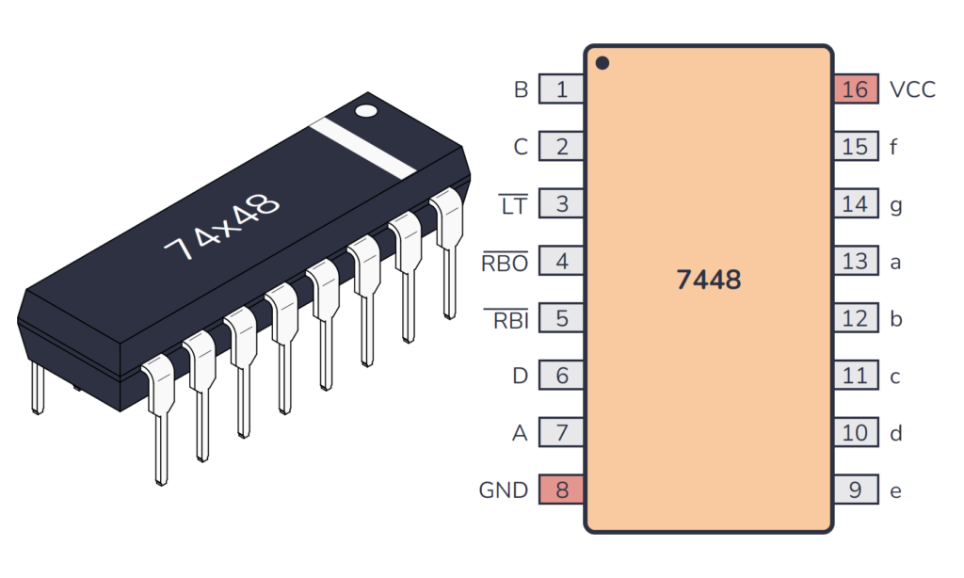
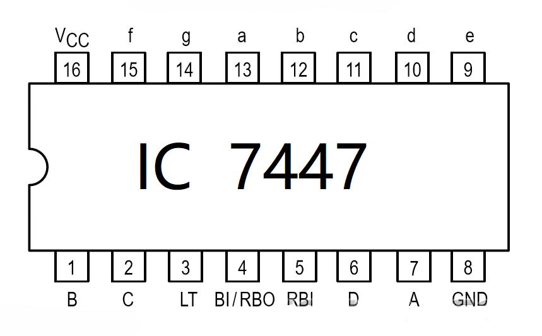
7447 & 7448 ICs
These are BCD to 7-segment decoder/driver ICs.
Data sheet of them

Slide 15
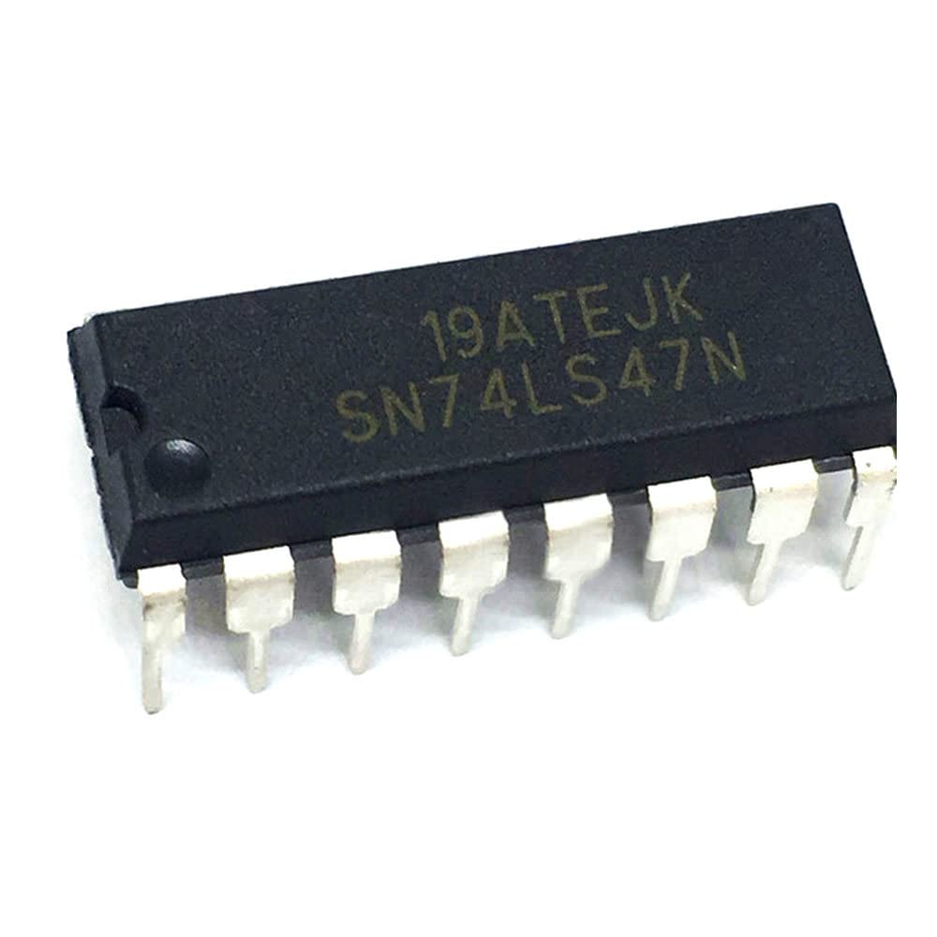
7447 IC
Drives Common Anode 7-segment displays.
Outputs are active-low.
Open collector outputs
Standard 16‑pin DIP package with etched markings like SN74LS47N or HD74LS47P-
typical TTL logic IC hardware

Slide 16
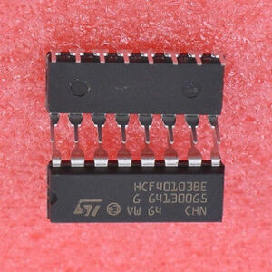
7448 IC
Drives Common Cathode7-segment displays.
Outputs are active-high.
Buffered outputs
he SN74LS48 / 74LS48 / 7448 is a TTL logic IC that decodes a 4‑bit BCD

Slide 17
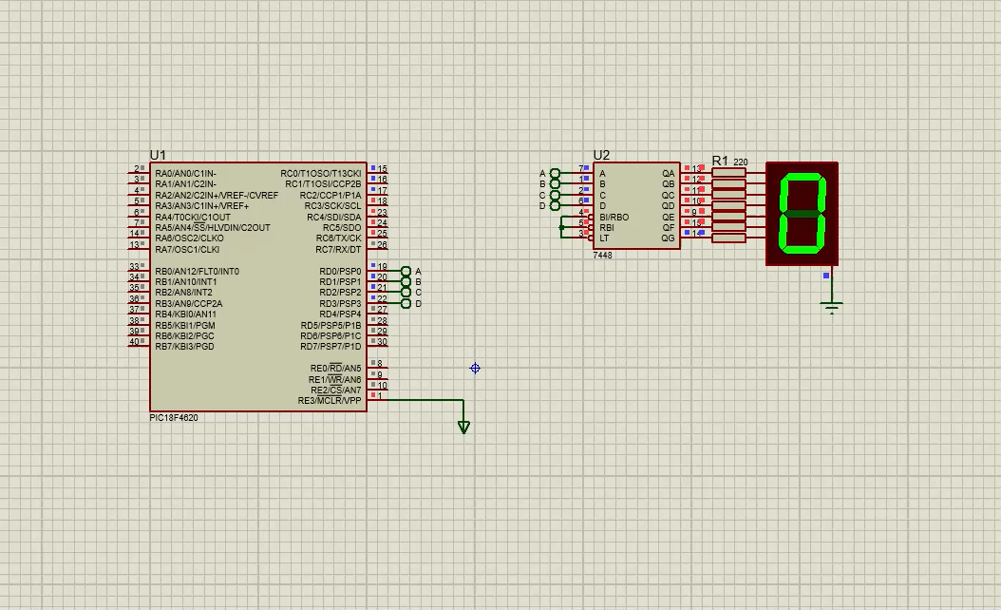

Slide 18
Multiplexer
A Digital Device That Selects One Input From Multiple Inputs And Sends It To The Output, Based On Control Signals.
S1 | S0 | Output Y
0 | 0 | I0
0 | 1 | I1
1 | 0 | I2
1 | 1 | I3
Importance Reduces number of wires Efficient Data Routing flexible digital systems.

Slide 19
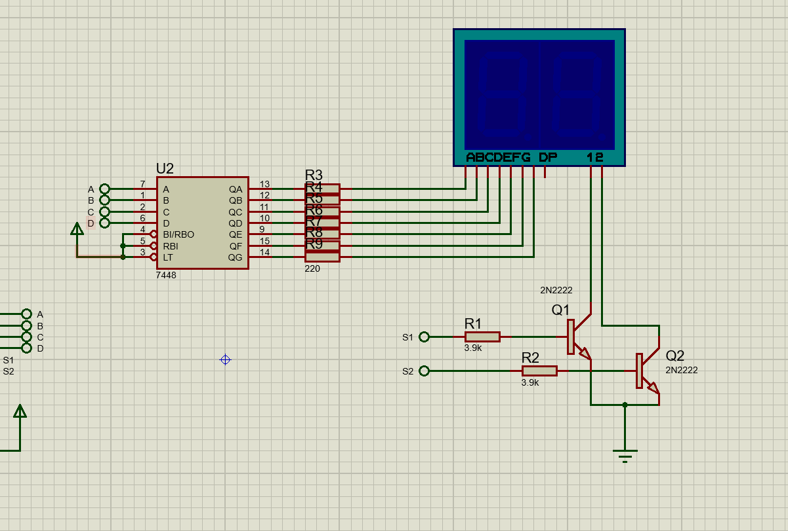

Slide 20

Thanks for
your Time
Any Questions

